Slide 1

FPT EDUCATION
Internet of Things (IoT):
Overview and Applications
Dang Van Hieu
Date: 01/08/2025
Version 2.0

Slide 2
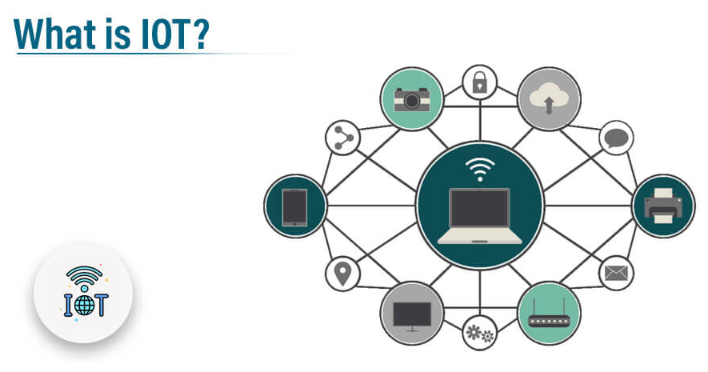
Introduction

Slide 3
Introduction
Definition: IoT refers to internet-connected devices that collect and transmit data.
Number of global connections: ~16.6 billion devices by the end of 2023, expected to reach ~27 billion by 2025 (iot-analytics.com)
Market size: Projected to be $618 billion in 2025, growing to $3.6 trillion by 2034 (softteco.com)

Slide 4
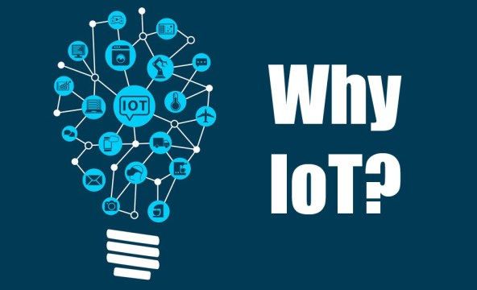
Key IoT Trends (2025)

Slide 5
Key IoT Trends (2025)
Industrial IoT (IIoT)
Edge Computing & AIoT
5G/Private 5G/LPWA (e.g., NB‑IoT)
Security and Sustainable IoT (Green IoT

Slide 6
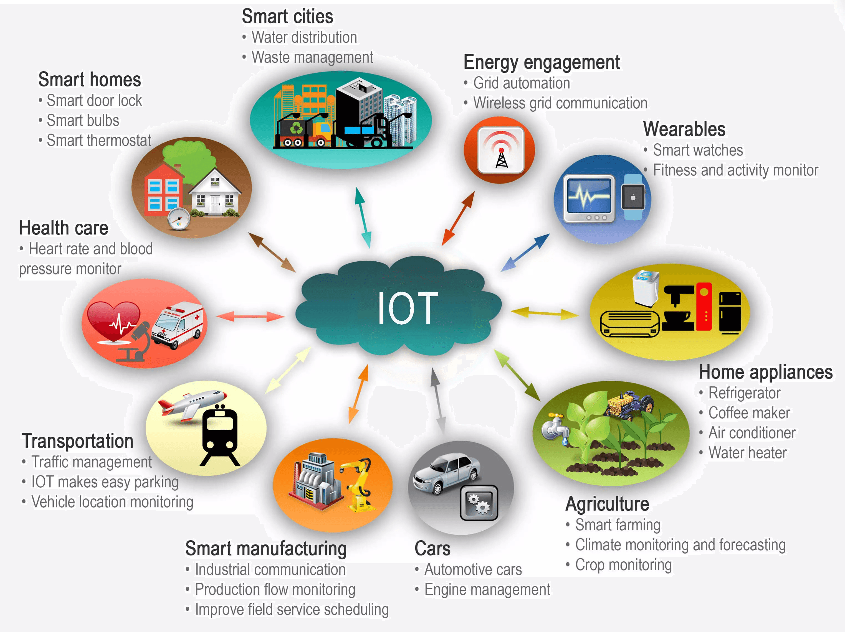
IoT Application

Slide 7
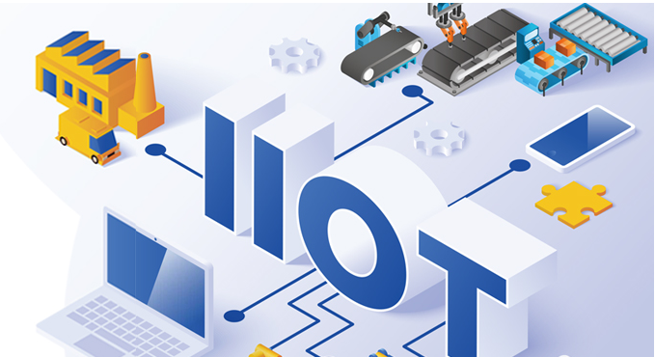
IoT Application
Industrial IoT (IIoT)
Reduces machine downtime – boosts productivity by up to 25% – cuts maintenance costs by 30%
Real-time data synchronization from machines, robots, and operators – enables automation and process optimization

Slide 8
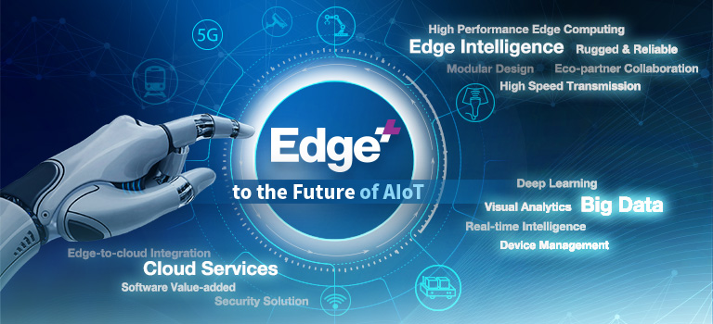
IoT Application
Edge Computing & AIoT
Local data processing reduces latency, saves bandwidth, and enhances security
AI integrated at the edge allows immediate data analysis and automated alerts

Slide 9

IoT Application
5G, NB‑IoT, and Private Networks
5G enables low latency and high bandwidth for real-time industrial and traffic applications
NB‑IoT used for utilities and public alerts (e.g., Vodafone Spain with 9.3 million connected devices for water meters and emergency V16 lights)

Slide 10
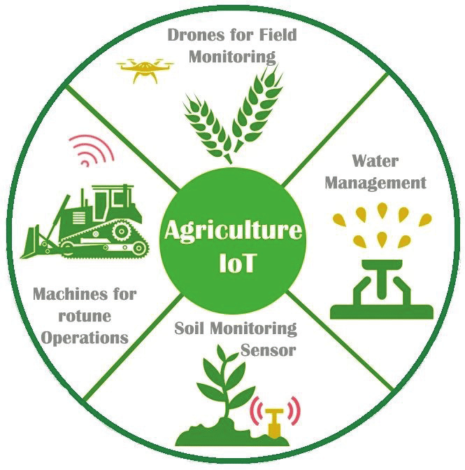
IoT Application
IoT in Agriculture (Precision Farming)
Soil, water, and nutrient sensors adjust irrigation and fertilizer in real-time
New technologies: biodegradable sensors, drones – improve yield and resource efficiency

Slide 11
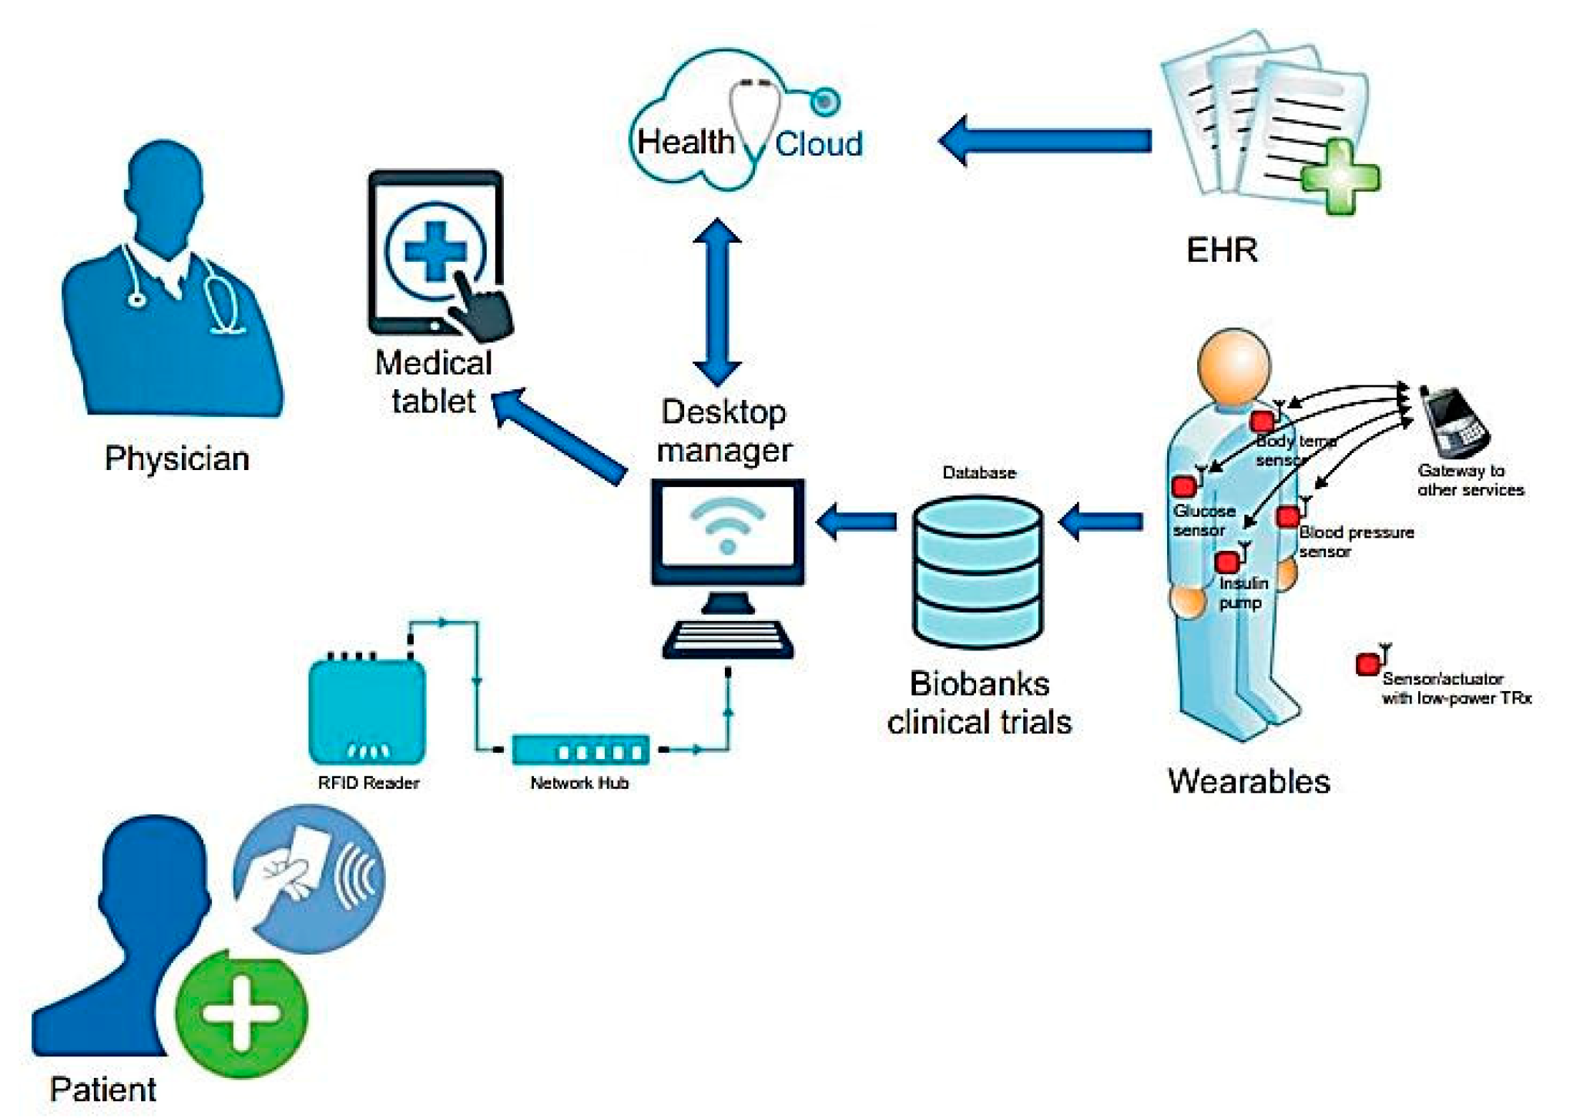
IoT Application
IoT in Healthcare (IoMT)
Wearables monitor heart rate, SpO₂, and sleep (e.g., smartwatches)
Smart hospital beds automatically adjust and detect patient movement
“Virtual Wards”: remote monitoring with IoT sensors and telehealth services

Slide 12
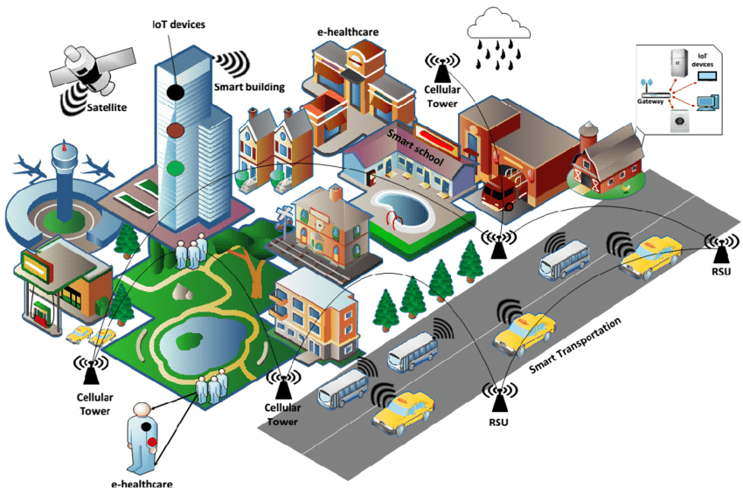
IoT Application
IoT in Smart Cities
Urban infrastructure management: water systems, streetlights, traffic, and waste
Smart sensors support water monitoring and road safety (e.g., emergency lights)

Slide 13
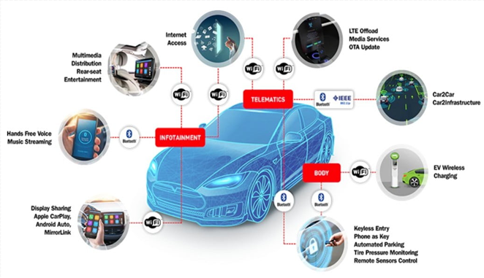
IoT Application
IoT in Vehicles (IoV)
Vehicles communicate with each other and infrastructure (V2V and V2X)
Connected vehicles enable OTA updates, accident alerts, and real-time navigation

Slide 14
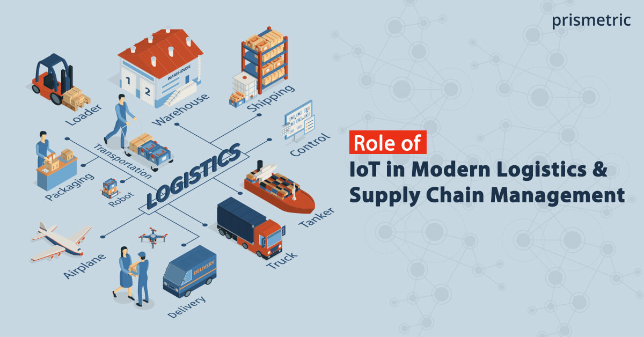
IoT Application
IoT in Logistics & Supply Chain
IoT sensors track shipment location, temperature, and humidity
Automation in warehouses: robots, RFID, material flow optimization

Slide 15
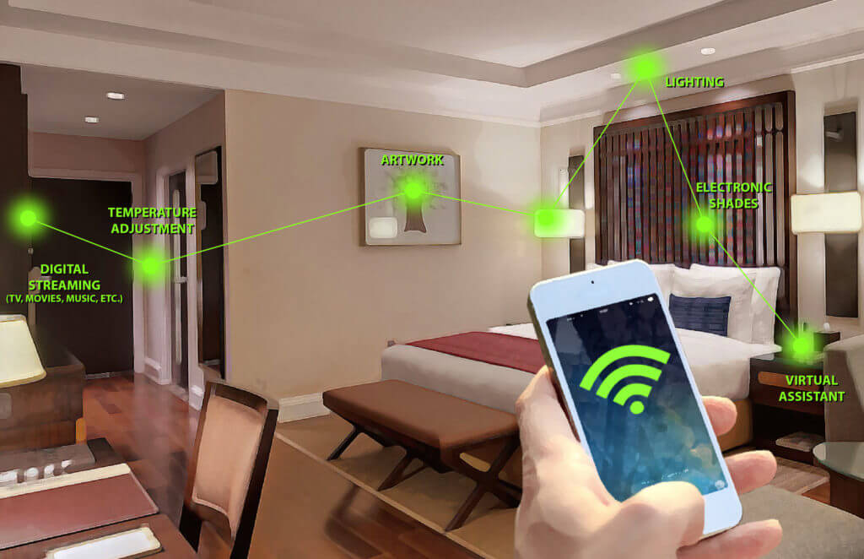
IoT Application
IoT in Hospitality & Smart Homes
Hotels optimize staffing, HVAC, and lighting using IoT
Smart homes feature automated lighting, cleaning robots, security, and elderly care systems

Slide 16
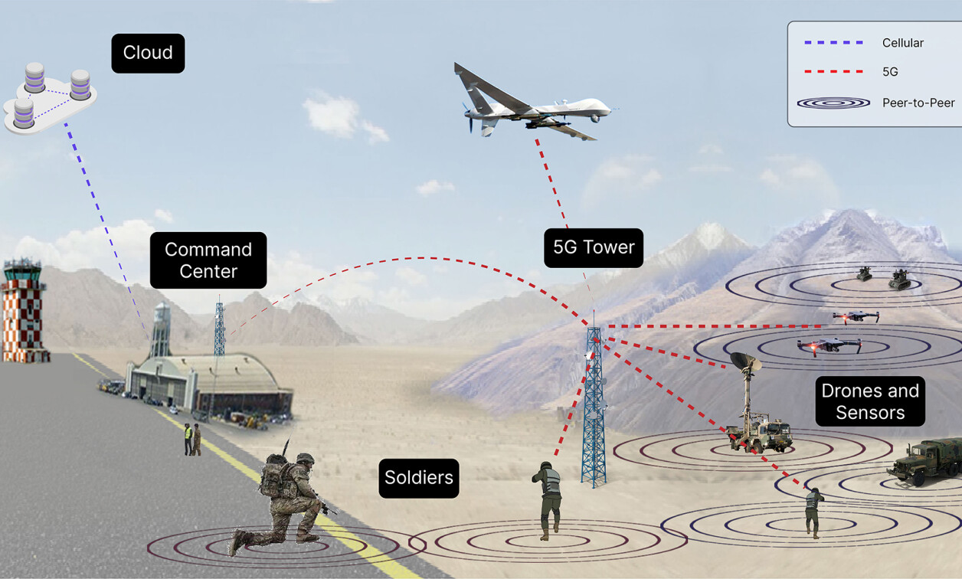
IoT Application
IoT in Security & Defense
Research shows IoT plays a critical role in military and emergency applications for safety and resource management

Slide 17
IoT Challenge
Challenge 1: Security & Privacy Risks
Problem: Billions of connected devices → huge attack surface
Vulnerabilities in hardware, outdated firmware, default passwords
Examples: Mirai botnet (DDoS via IoT cameras), healthcare data leaks
Implication: Loss of trust, legal violations (e.g., GDPR)

Slide 18
IoT Challenge
Solution: Secure-by-Design IoT
End-to-end encryption between devices and cloud
Use of secure boot, device identity management, and zero-trust architecture
Firmware Over-The-Air (FOTA) for timely updates
Adoption of IoT security frameworks (e.g., NIST, ETSI)

Slide 19
IoT Challenge
Challenge 2: Interoperability & Standardization
Problem: Diverse vendors → incompatible protocols & platforms
Lack of unified standards leads to data silos and limited scalability
Hinders integration across smart cities, industries, homes

Slide 20
IoT Challenge
Solution: Open Standards & Ecosystem Collaboration
Promotion of open-source platforms (e.g., Matter, MQTT, OPC-UA)
Industry alliances: IoT Consortium, Industrial Internet Consortium
Government involvement in regulation and certification (e.g., FCC, CE)
Modular and API-based architecture to support interoperability

Slide 21
IoT Challenge
Challenge 3: Challenge 3: Power Consumption & Sustainability
Key Issues:
Many IoT devices operate in remote or off-grid areas with no stable power supply
Regular battery replacement is costly, time-consuming, and environmentally unfriendly
IoT data centers (cloud & edge) consume significant energy, contributing to CO₂ emissions, which conflict with global green targets
Consequences:
Limits scalability of large-scale IoT deployments
Creates a conflict between IoT growth and carbon neutrality goals

Slide 22
IoT Challenge
Solution: Green IoT & Energy-Efficient Technologies
Technological Solutions:
Use of self-powered sensors that harvest:
Solar energy, vibrations, magnetic fields, or ambient heat
Development of next-gen ultra-low-power IoT chipsets
Integration of local AI (Edge AI) to minimize reliance on cloud processing
Sustainable Development Approaches:
Circular device design:
Recyclable materials, repairable components, reduced e-waste
Deploy “Green IoT” models in agriculture, transportation, and smart homes

Slide 23
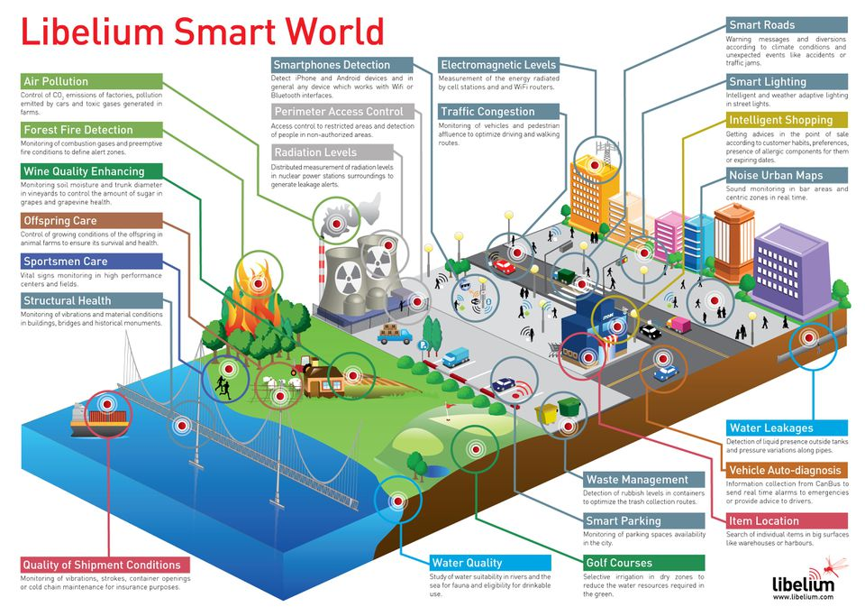
The smart world of the future – using Iot

Slide 24
Reference
[1]. https://sam-solutions.com/
[2]. https://inhandgo.com/
[3]. https://www.kajeet.com/
[4]. https://101blockchains.com/
[5]. https://app.cirkitdesigner.com/
[6]. https://www.circuito.io/
[7]. https://imaginovation.net/blog/iot-development-trends-predictions/?utm_source=chatgpt.com
Notes:
Thiết kế và mô phỏng.
https://app.cirkitdesigner.com/

Slide 25
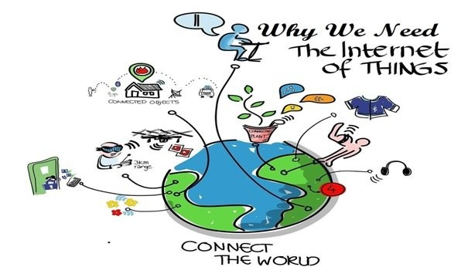
Thank you!

